Slide 1


Git and Azure DevOps

Slide 2
What is Git?
Git is free and open source, distributed version control system designed by Linus Torvalds (the creator of Linux) to handle everything, from small to very large projects. It stores the history of our project in the form of snapshots called commits.
It is the most used version control system in the world currently.
Git can be accessed via command line or through desktop GUI client as: TortoiseGit, GitKraken, Fork and others.
Online hosts as GitHub and BitBucket can be used for storing of copy of the Git repository, enabling smoother collaboration with other developers.

Slide 3

Git is NOT the same as GitHub
Git is the software itself, designed to be used with different commands for managing of projects and their versions. This software tracks our changes in the project.
GitHub is a web host (website) in which we can store our repositories. Git software runs in GitHub.
We can use Git without GitHub, but we cannot use GitHub without Git.
is NOT

Slide 4
Git commands (console)
git init - initializes a new git repo locally
git add - is used for staging of all changes that we want to be part of our next commit
git commit - creates commit which in general speaking means a snapshot of our repository for the certain moment.
git push - sends our local work (all commits) to the remote central copy of our repository which is placed in GitHub, Azure DevOps or elsewhere
git pull - get all new work from the remote central repository that is not in our local repository
git merge - merges the work from two branches.
git checkout – switch to another branch (there is switch command as well)

Slide 5
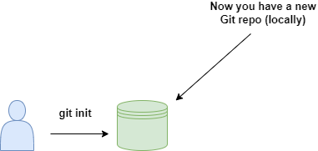
git init
git init - initializes a new git repository locally

Slide 6
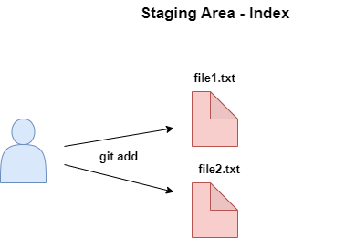
git add
git add - is used for staging of all changes that we want to be part of our next commit

Slide 7
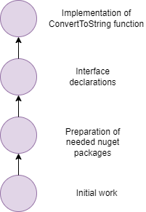
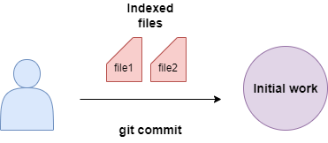
git commit
Commits

Slide 8
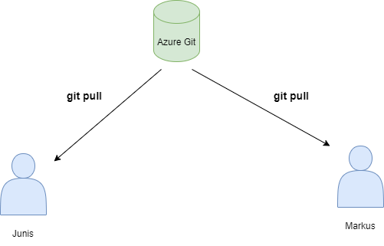
git pull
git pull - get all new work from the remote central repository that is not in our local repository

Slide 9

What is a branch in Git?
A branch represents an independent line of development.
In Git a branch is a pointer to specific commit
It is fundamental feature of Git and is absolutely crucial for developing phase.
Whit branches, many people may work on different features and can merge after that their work into the main branch.

Slide 10
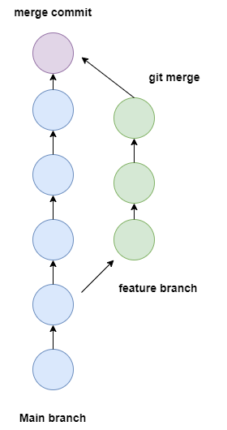
git merge
git merge - merges the work from two branches.

Slide 11




Git GUI clients
Fork
Tortoise Git

